Slide 1


Rev Up EV round 3 Kick Off Meeting
Natasha Allan, Associate Deputy Director for Career & Technical Education (CTE), ICCB
Dana Wynn, Director for Clean Energy Programs, ICCB
Chris Blankenhorn, Assistant Director for Compliance, ICCB
March 11, 2025
Notes:
Tasha

Slide 2
Meet the Team
Notes:
Tasha

Slide 3
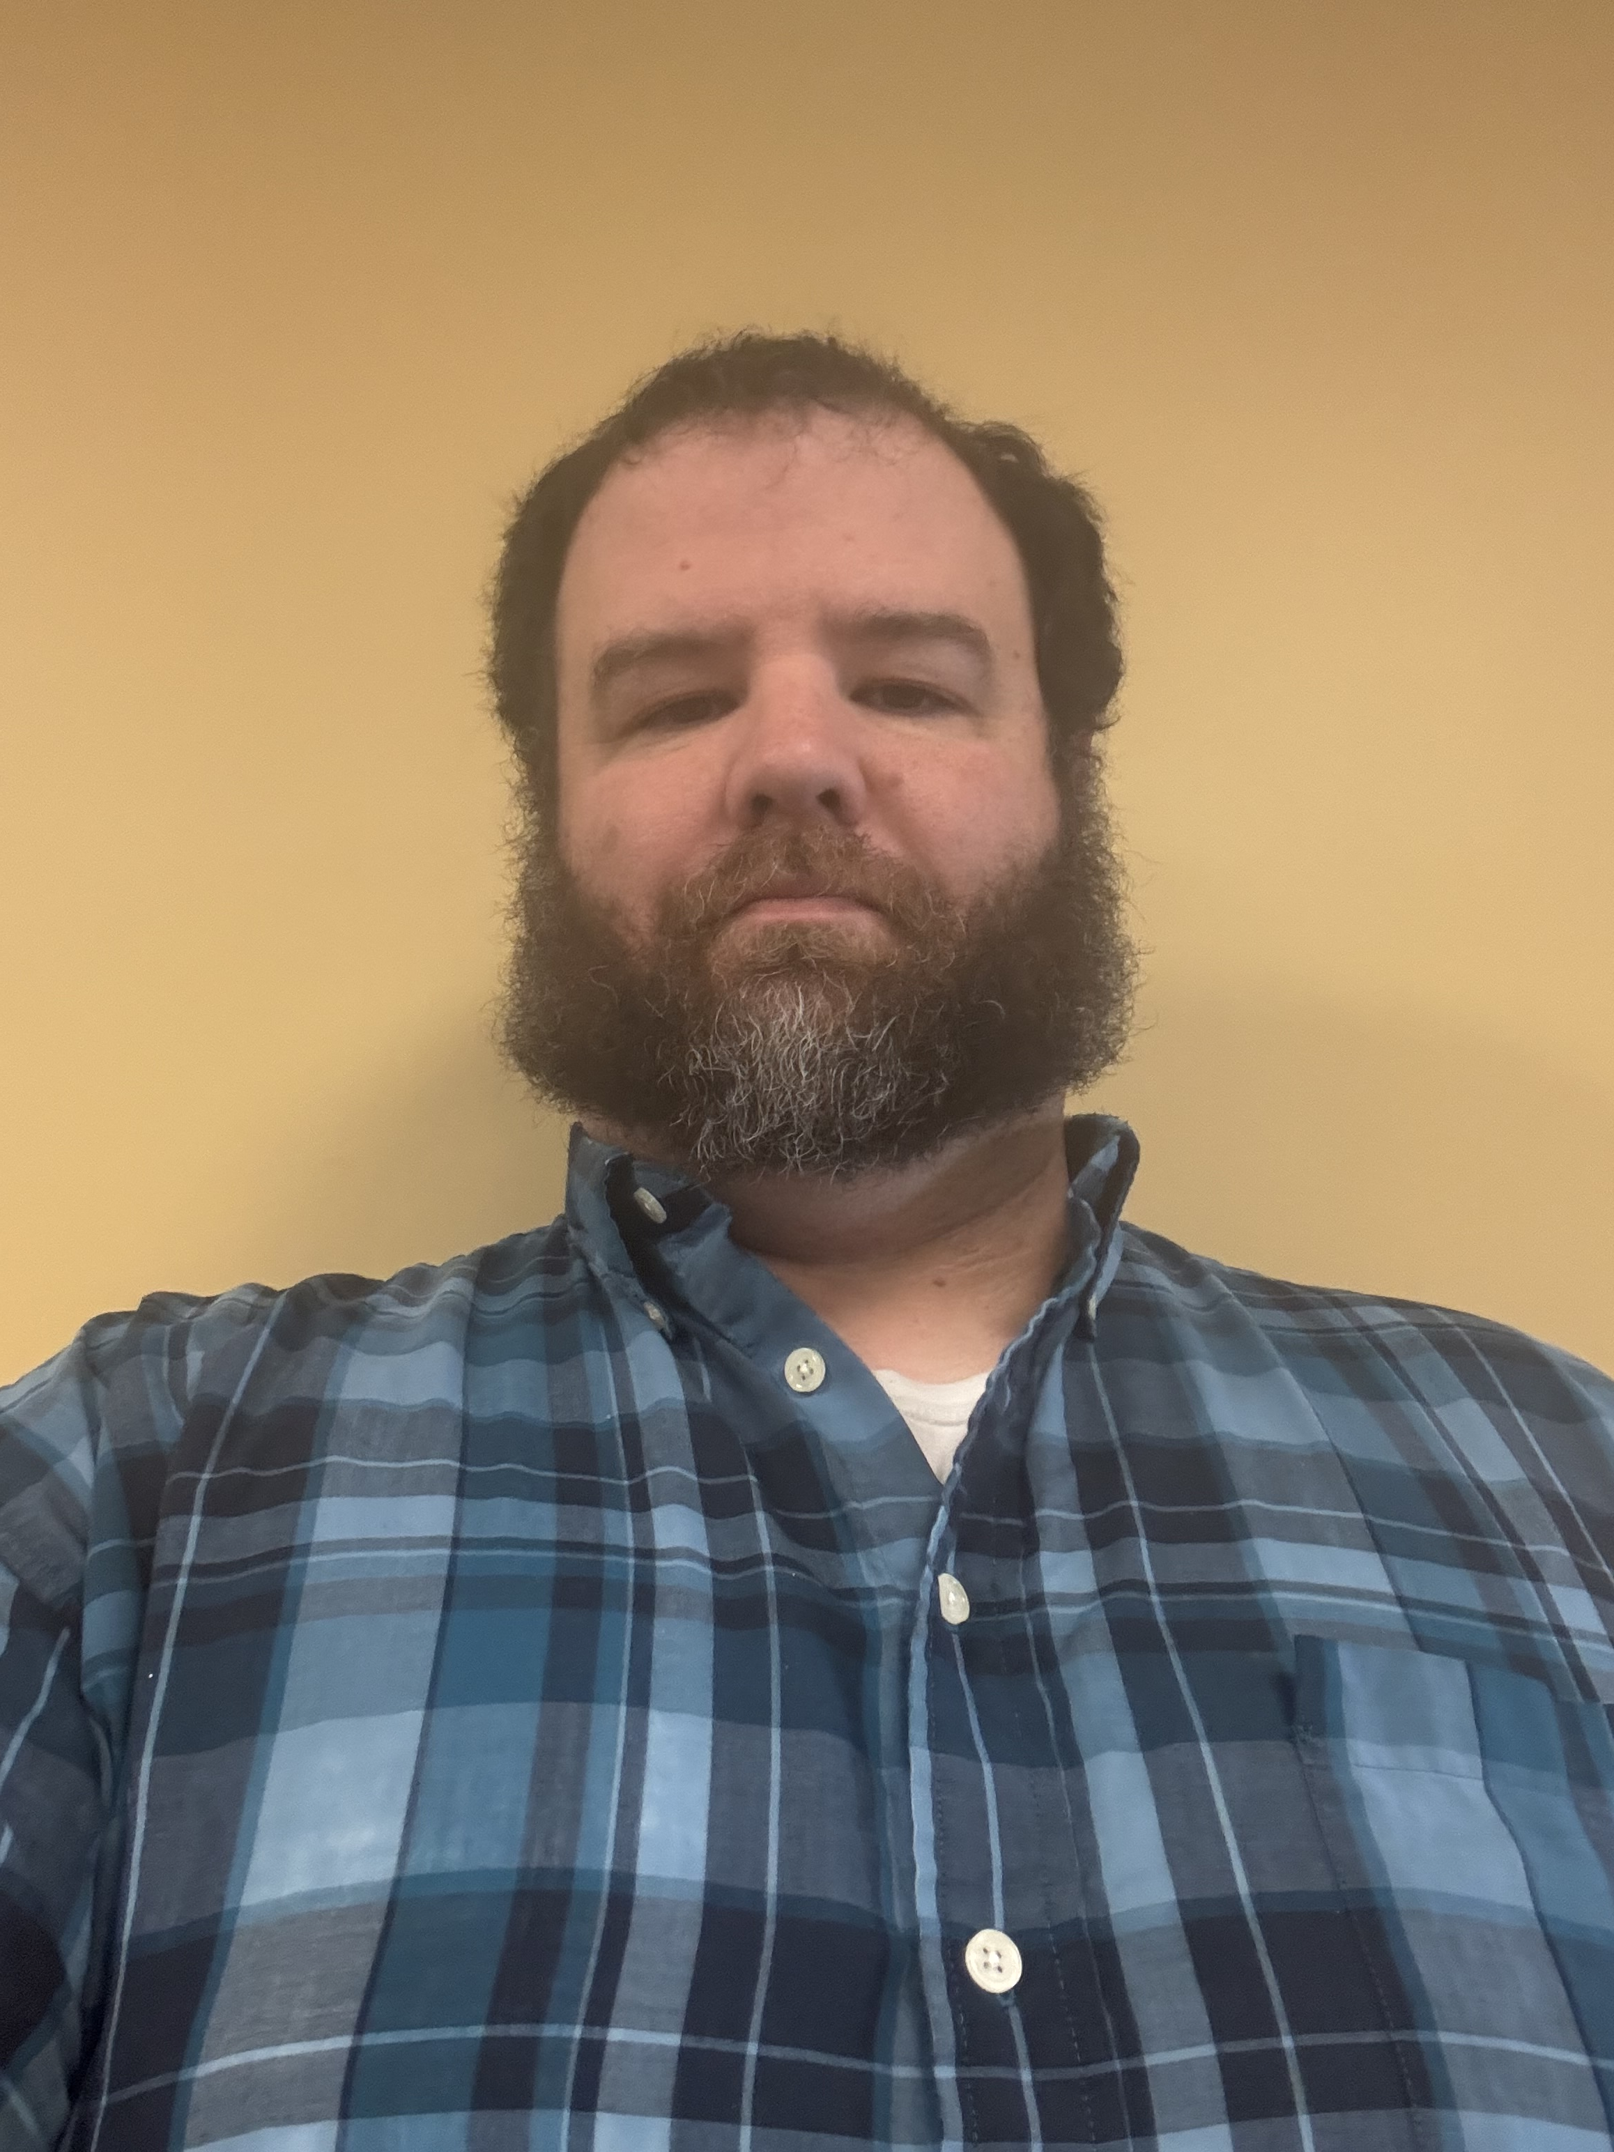
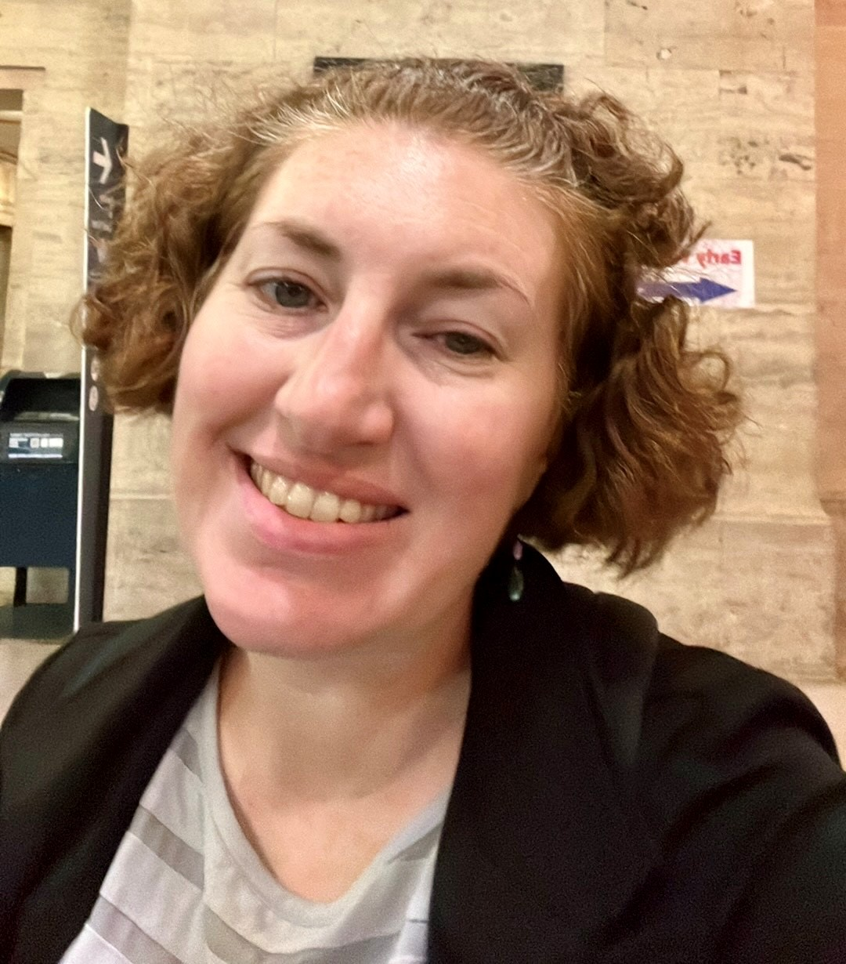
Illinois Community College Board
Natasha Allan, Associate Deputy Director for Career & Technical Education (CTE)
Dana Wynn, Director for Clean Energy Programs
Chris Blankenhorn, Assistant Director for Program Compliance
Notes:
Tasha
Dana – self introduce
Chris– self introduce

Slide 4
Agenda
Background
Required Activities and Deliverables
Professional Development and Technical Assistance
Administrative Requirements and Reporting
Q and A
Notes:
Dana

Slide 5
Background
Notes:
Dana

Slide 6
Funding Overview
ICCB is awarding approximately $7.361 million in round 3 of the Rev Up EV initiative through a competitive grant fund to promote the scale of EV technology programs, as well as advanced manufacturing programs that support EV infrastructure more broadly by way of two competitive grant opportunities:
Objective A: Capacity Building – up to $90,000: two (2) new colleges
Objective B: Development, Revision, Expansion - $100,000-525,000: seventeen (17) colleges
Notes:
Dana
Totals updated 3/6/25 –DW

Slide 7
Objective A: Building Capacity for Electric Vehicles
Designed to support a cohort of community colleges to build capacity at their institutions and communities for the transition to EV technology.
Intended to prepare and position institutions for future funding opportunities and to build capacity for program development and implementation.
Use of funds could include, but not necessarily be limited to, employer and community engagement, participation in the EV network, curriculum mapping and development, professional development and training for faculty, community needs assessment.
Maximum: $90,000 per college
One year grant (January 1 – December 31, 2025)
Notes:
Dana

Slide 8
Objective B: Electric Vehicle Technology Development and Expansion
Focused on developing and/or expanding EV Technology and related programs.
Prioritizes education and training programs that span across the EV Technology occupational continuum from development and production to maintenance of Electric Vehicles, as well as installation and maintenance of critical infrastructure
Award range: $100,000-$525,000 per college
1.5-year grant (January 1, 2025 – June 30, 2026)
Notes:
Dana

Slide 9
Priority Programs
Electrical Engineering Technology
Mechatronics
Electrical Technology
Manufacturing Engineering Technology
Alternative Fuel Vehicle Technology
High Voltage Battery Technology
Automotive Technology
Software Development
Programs aligned to industry certifications (e.g. TESLA Independent Repair Certified).
Programs that advance the development and maintenance of EV charging infrastructure.
Other programs of interest are identified in the Illinois Clean Energy Jobs and Training Program Inventory.
Proposals will be evaluated with a focus on high demand areas, a sound labor market argument to meet statewide need and capacity for college’s focusing in those areas, and the ability to effectively accelerate training.
It should be noted that the ICCB program approval process requires a labor market focused argument for program approval.
Notes:
Dana

Slide 10
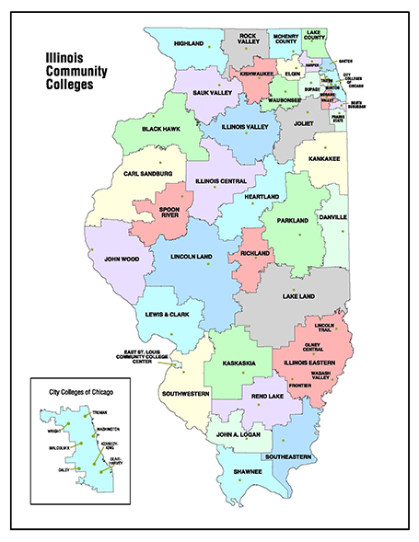
Rev Up EV round 3
College of Lake County
Elgin Community College
Harry S Truman College
Heartland Community College
Illinois Central College
John A Logan College
Kaskaskia College
Kennedy-King College
Kishwaukee College
Lake Land College
Lincoln Land Community College
Moraine Valley Community College
Oakton College
Olive-Harvey College
Rend Lake College
Richard J Daley College
Rock Valley College
Southeastern Illinois College
Triton College
v
Notes:
Dana

Slide 11
Overall Grant Focus and Goals: R1-R3
Programs to be Developed | Number of Colleges | Programs to Revise/Expand | Number of Colleges
Alternative Fuel Technology Technician | 15 | Automotive Technology | 23
EV Infrastructure Installer | 7 | Alternative Fuel Technology Technician | 5
Heavy Duty EV Technology | 5 | Electrical Engineering | 3
High Voltage Battery Technician | 4
Notes:
Dana
Up to date 8/6/24; UPDATE to include R3 when Program Offerings Charts received.

Slide 12
Overall Grant Focus and Goals – Round 3
Programs to be Developed | Number of Colleges | Programs to Revise/Expand | Number of Colleges
Alternative Fuel Technology Technician | - | Automotive Technology | -
EV Infrastructure Installer | - | Alternative Fuel Technology Technician | -
Heavy Duty EV Technology | - | Electrical Engineering | -
High Voltage Battery Technician | -
Number of Students to be Enrolled | Number of Students to Complete | Number of Employers to Engage | Number of Education Partnerships
 |  | 214 | 146
2823
1161
Notes:
Dana
Up to date 8/6

Slide 13
Overall Grant Focus and Goals: R1-R3
R1
Number of Students to be Enrolled | Number of Students to Complete | Number of Employers to Engage | Number of Education Partnerships
2180 | 1744 | 347 | 196
R2
Number of Students to be Enrolled | Number of Students to Complete | Number of Employers to Engage | Number of Education Partnerships
2544 | 1870 | 417 | 238
R3
Number of Students to be Enrolled | Number of Students to Complete | Number of Employers to Engage | Number of Education Partnerships
2823 | 1161 | 214 | 146
Notes:
Dana
Up to date 3/11/25

Slide 14
Required Activities
Notes:
Dana

Slide 15
Required Activities | Objective A: Capacity- Building | Objective B: Development and Expansion
Participation in EV Network
Employer and Community Engagement
Pathway Mapping (i.e., dual credit, adult education integrated education and training, non-credit to credit, as appropriate)
Build Capacity and Infrastructure
Develop New Programs (as LMI requires)
Revise or Expand Existing Programs (as LMI requires)
Support Students Enrolled in Eligible Programs
Notes:
Dana

Slide 16
Quarterly Reporting Templates & Instructions
Notes:
Dana

Slide 17
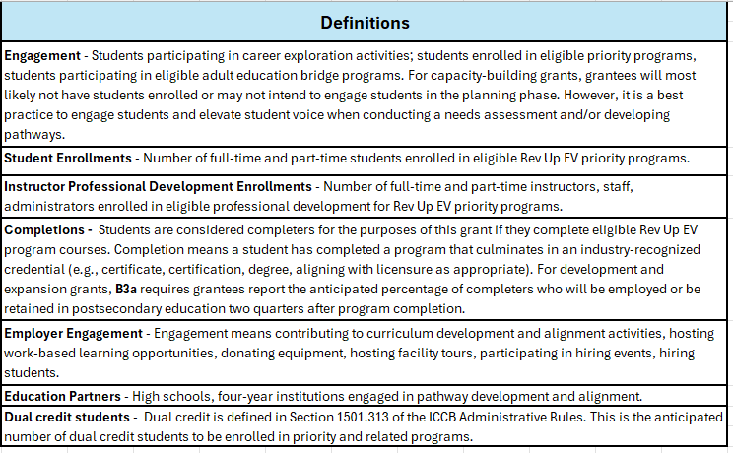
Notes:
Dana – review definitions – these are the numbers colleges are reporting in the performance metrics table to ICCB each quarter during the Rev Up EV grant period.

Slide 18
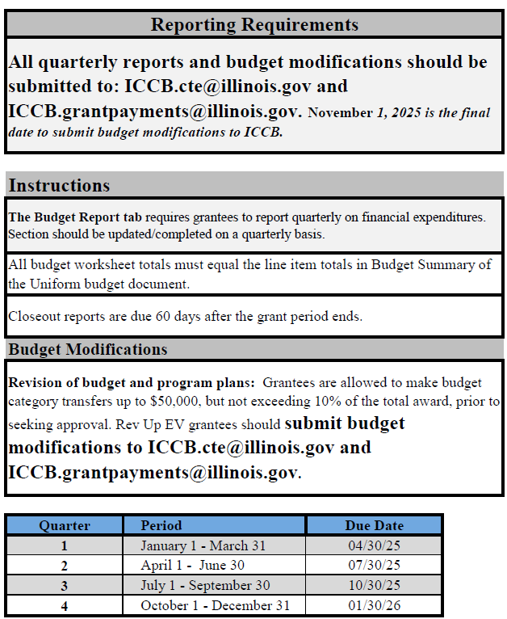
Notes:
Dana – Objective A reporting instructions – including instructions for submitting budget modifications and quarterly reports to both the ICCB.CTE@illinois.gov and ICCB.grantpayments@illinois.gov email addresses by the due dates. Obj A. group - November 1, 2025, is the last day to submit budget modifications for review.
If this guidance is not followed, your reports will be marked late until the ICCB.cte@Illinois.gov email inbox RECIEVES your colleges report. Although the Rev Up EV grant does not monitor, this is import for the chain of custody process for reporting.

Slide 19
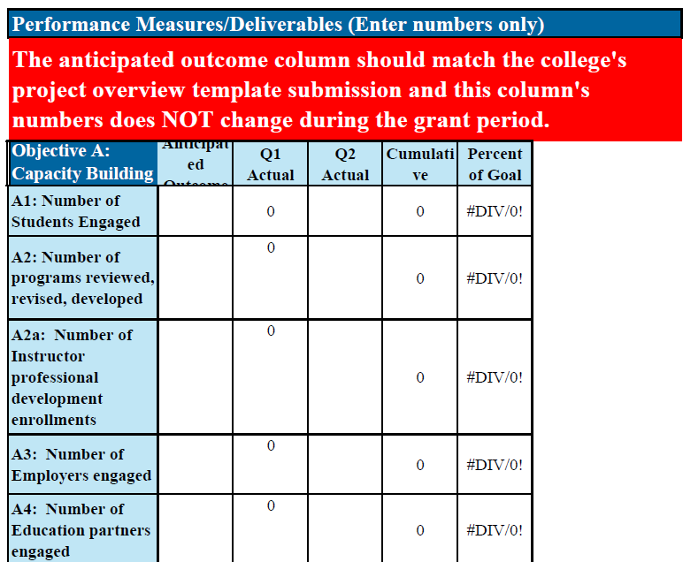
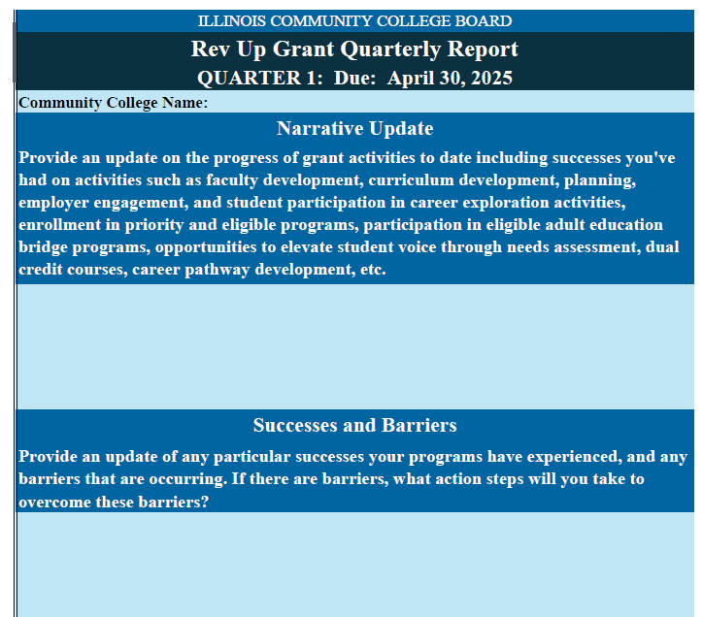
Notes:
Dana – Objective A quarterly report template form – narrative on the left, performance metrics on the right.

Slide 20
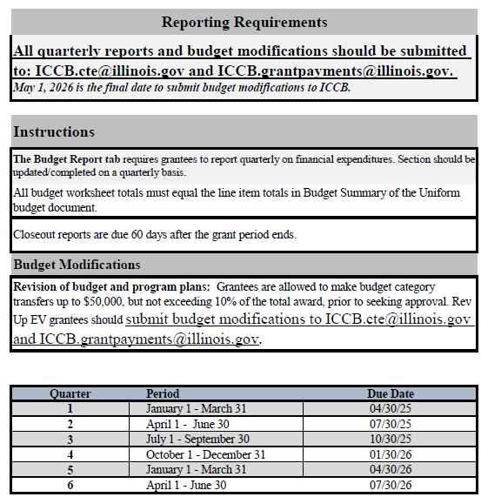
Notes:
Dana - Objective B reporting instructions – including instructions for submitting budget modifications and quarterly reports to both the ICCB.CTE@illinois.gov and ICCB.grantpayments@illinois.gov email addresses by the due dates.
Obj. B group – May 1, 2026, is the last day to submit budget modifications for review.

Slide 21
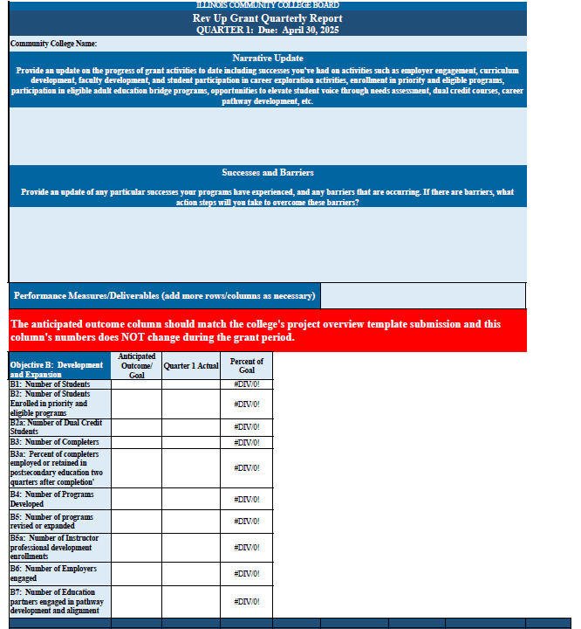
Notes:
Dana – Objective B quarterly report template form

Slide 22
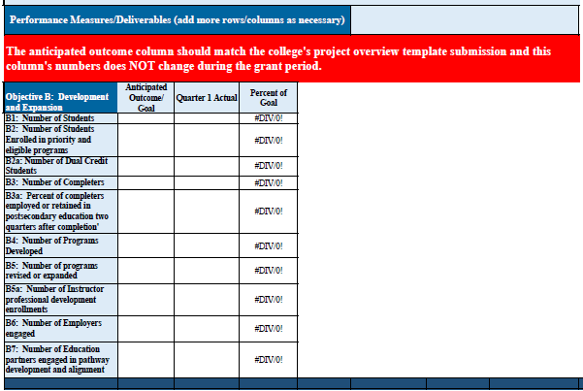
Notes:
Dana – Obj. B performance metrics table – BE SURE to fill out this out completely each quarter. If the number is zero, report it.

Slide 23
Administrative Requirements and Reporting
Notes:
Chris

Slide 24
Grant Deliverables
Carry out
Carry out deliverables of the proposed scope of work, encompassing all required activities for the selected Objective.
Report on
Report on achievement of performance metrics via required quarterly reporting and other supplemental reports as necessary.
Submit
Submit required programmatic and fiscal reports on a quarterly basis per the schedule below to ICCB.cte@illinois.gov and ICCB.grantpayments@illinois.gov . Reporting templates will be shared after today’s kickoff meeting.
Participate in
Participate in any required Operational Meetings or learning workshops, including those led by IGEN through the EV Network.
Provide
Provide to the ICCB copies of any curriculum, documents, toolkits, modules, etc., that are developed because of these grant funds.
Notes:
Chris

Slide 25
Important Dates
January 1, 2025: Grant Start Date; Funds can begin to be expended
April 30, 2025: Quarter 1 Report Due to iccb.cte@illinois.gov and ICCB.grantpayments@illinois.gov.
July 30, 2025: Quarter 2 Report Due to iccb.cte@illinois.gov and ICCB.grantpayments@illinois.gov.
October 30, 2025: Quarter 3 Report Due to iccb.cte@illinois.gov and ICCB.grantpayments@illinois.gov.
November 1, 2025: Budget Modifications/Extension Requests due for Capacity Grants
December 31, 2025: Capacity-Building Grant End Date
January 30, 2026: Quarter 4 Report Due to iccb.cte@illinois.gov and ICCB.grantpayments@illinois.gov.
April 30, 2026: Quarter 5 Report Due to to iccb.cte@illinois.gov and ICCB.grantpayments@illinois.gov. (For B Grants Only)
May 1, 2026: Budget Modifications due for Development/Expansion Grants
June 30, 2026: Development/Expansion Grants End Date
July 30, 2026: Quarter 6 Report Due to iccb.cte@illinois.gov and ICCB.grantpayments@illinois.gov. (For B Grants Only)
*Closeout reports are due to ICCB.cte@illinois.gov and ICCB.grantpayments@illinois.gov 60 days after the end of the grant period.
Obj. A: due to ICCB February 28, 2026
Obj. B: due to ICCB August 30, 2026
Notes:
Chris

Slide 26
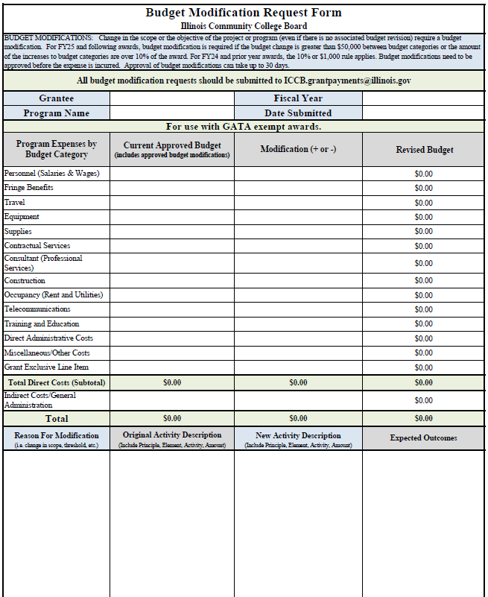
Budget Modifications
Budget Modifications
Submit to ICCB.cte@illinois.gov
Submit budget modifications to ICCB.cte@illinois.gov and ICCB.grantpayments@illinois.gov using the uniform non-GATA budget form template found on the ICCB grant opportunities webpage.
Notes:
Chris

Slide 27
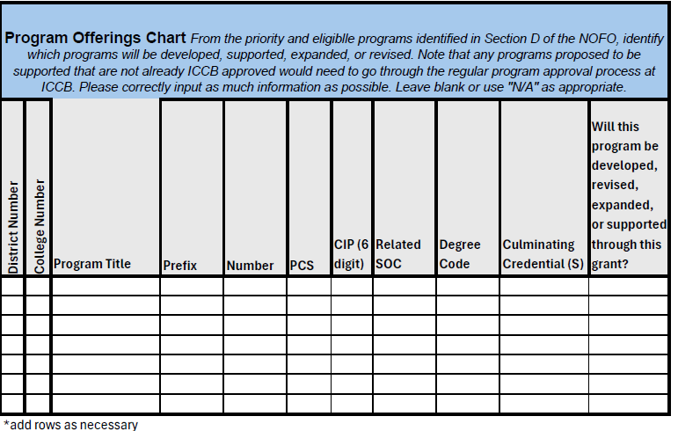
Performance Reporting
Program Offerings Chart
Colleges should complete this form and submit to ICCB.cte@illinois.gov.
Notes:
Chris
ICCB will reach out to primary and secondary contacts to get this information.

Slide 28
Objective A: Capacity-Building Outcomes
A1. Anticipated number of students to be engaged in this grant project. This refers to students participating in career exploration activities; students enrolled in priority and eligible programs, students participating in eligible adult education bridge programs. For capacity-building grants, grantees will most likely not have students enrolled or may not intend to engage students in the planning phase. However, it is a best practice to engage students and elevate student voice when conducting a needs assessment and/or developing pathways.
A2. Number of programs that will undergo development, review, or revision. For capacity-building grantees, it is not expected that programs will be developed or offered; however, as a part of the planning phase, colleges should be able to identify the programs that they anticipate reviewing, revising, or beginning the development process. The number of programs identified should match that listed on the Program Offerings Chart.
A3. Number of employers engaged. Engagement means contributing to curriculum development and alignment activities, hosting work-based learning opportunities, donating equipment, hosting facility tours, participating in hiring events, hiring students.
A4. Number of education partners (high schools, four-year institutions) engaged in pathway development and alignment.
Notes:
Dana

Slide 29
Objective B: Development and Expansion Outcomes
B1. Number of students to be engaged in this grant. This refers to students participating in career exploration activities; students enrolled in priority and eligible programs, students participating in eligible adult education bridge programs.
B2. Anticipated number of students to be enrolled in priority and related programs. Enrollment is defined as the number of full-time (considered 12 hours or more in a term or 24 hours or more in an academic year) and part-time students enrolled in priority and eligible programs.
B2a. Anticipated number of dual credit students. This metric is a subset of B2. Dual credit is defined in Section 1501.313 of the ICCB Administrative Rules. This is the anticipated number of dual credit students to be enrolled in priority and related programs. (Enrollment is defined as number of full-time and part-time students enrolled in priority programs).
B3. Anticipated number of completers. Students are considered completers for the purposes of this grant if they complete an eligible program in the academic year for which the grant is active. Completion means a student has completed a program that culminates in an industry-recognized credential (e.g. certificate, certification, degree). The count may be duplicated meaning, for example, that if a student completes a 16-week program in the fall semester and then transitions into another eligible program in the spring semester and completes, the student would be counted for two completions. The count will include students completing both credit and non-credit programs, that are on the eligible program list. All programs must be identified in the Program Overview Chart for approval by the ICCB. Completers may include students who began a program prior to the academic year for which the grant is being implemented. The grant program supports districts to implement activities that improve student retention.)
B3a. Anticipated percentage of completers who will be employed or be retained in postsecondary education two quarters after completion. This is a subset of B3.
Notes:
Dana

Slide 30
Objective B: Development and Expansion Outcomes Cont.
B4. Number of programs to be developed.
B5. Number of programs to be revised or expanded.
B6. Number of employers engaged. Engagement means contributing to curriculum development and alignment activities, hosting work-based learning opportunities, donating equipment, hosting facility tours, participating in hiring events, hiring students.
B7. Number of education partners (high schools, four-year institutions) engaged in pathway development and alignment.
Notes:
Dana

Slide 31

Professional Development and Technical Assistance
Notes:
Turn it over to IGEN

Slide 32
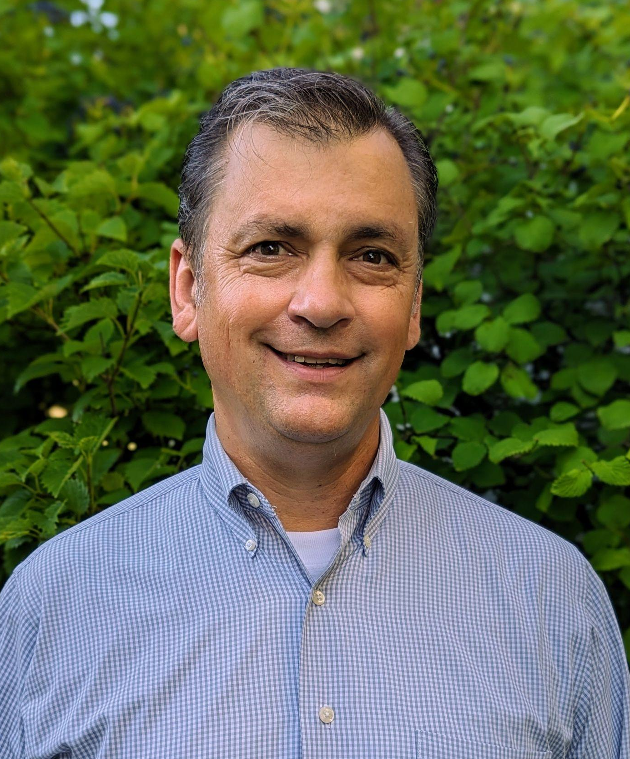
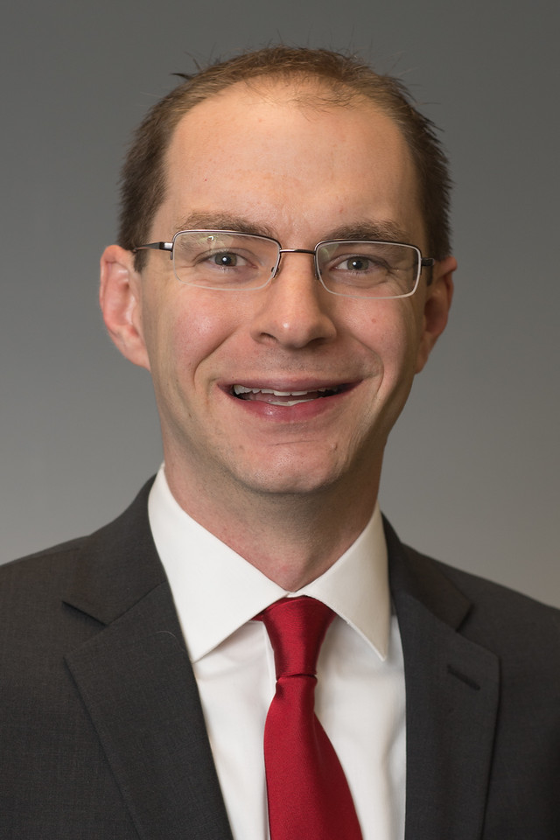
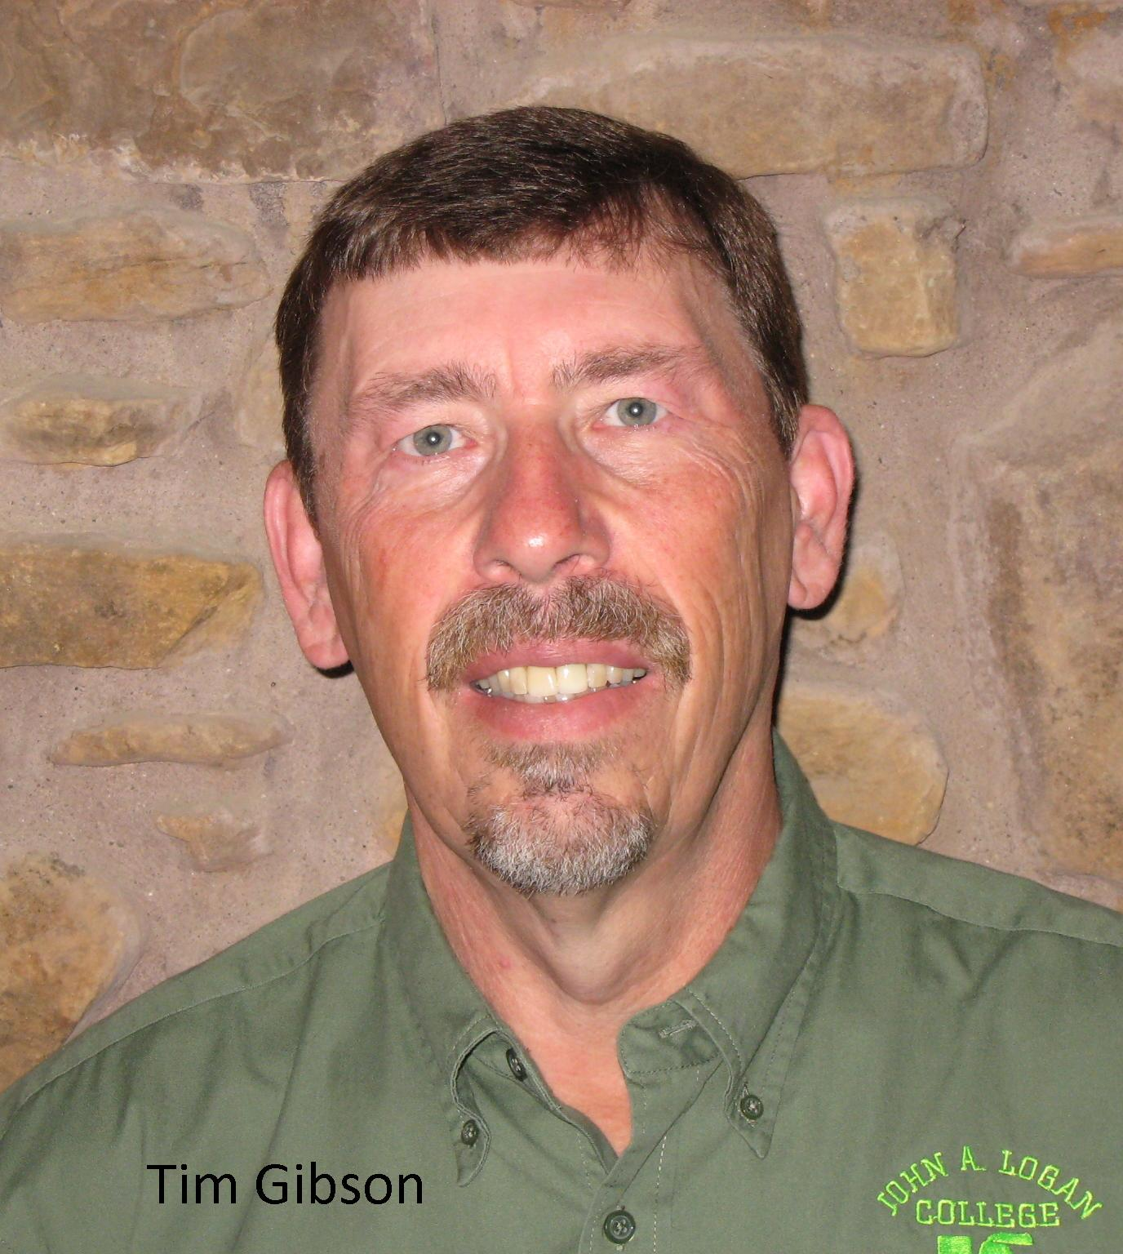
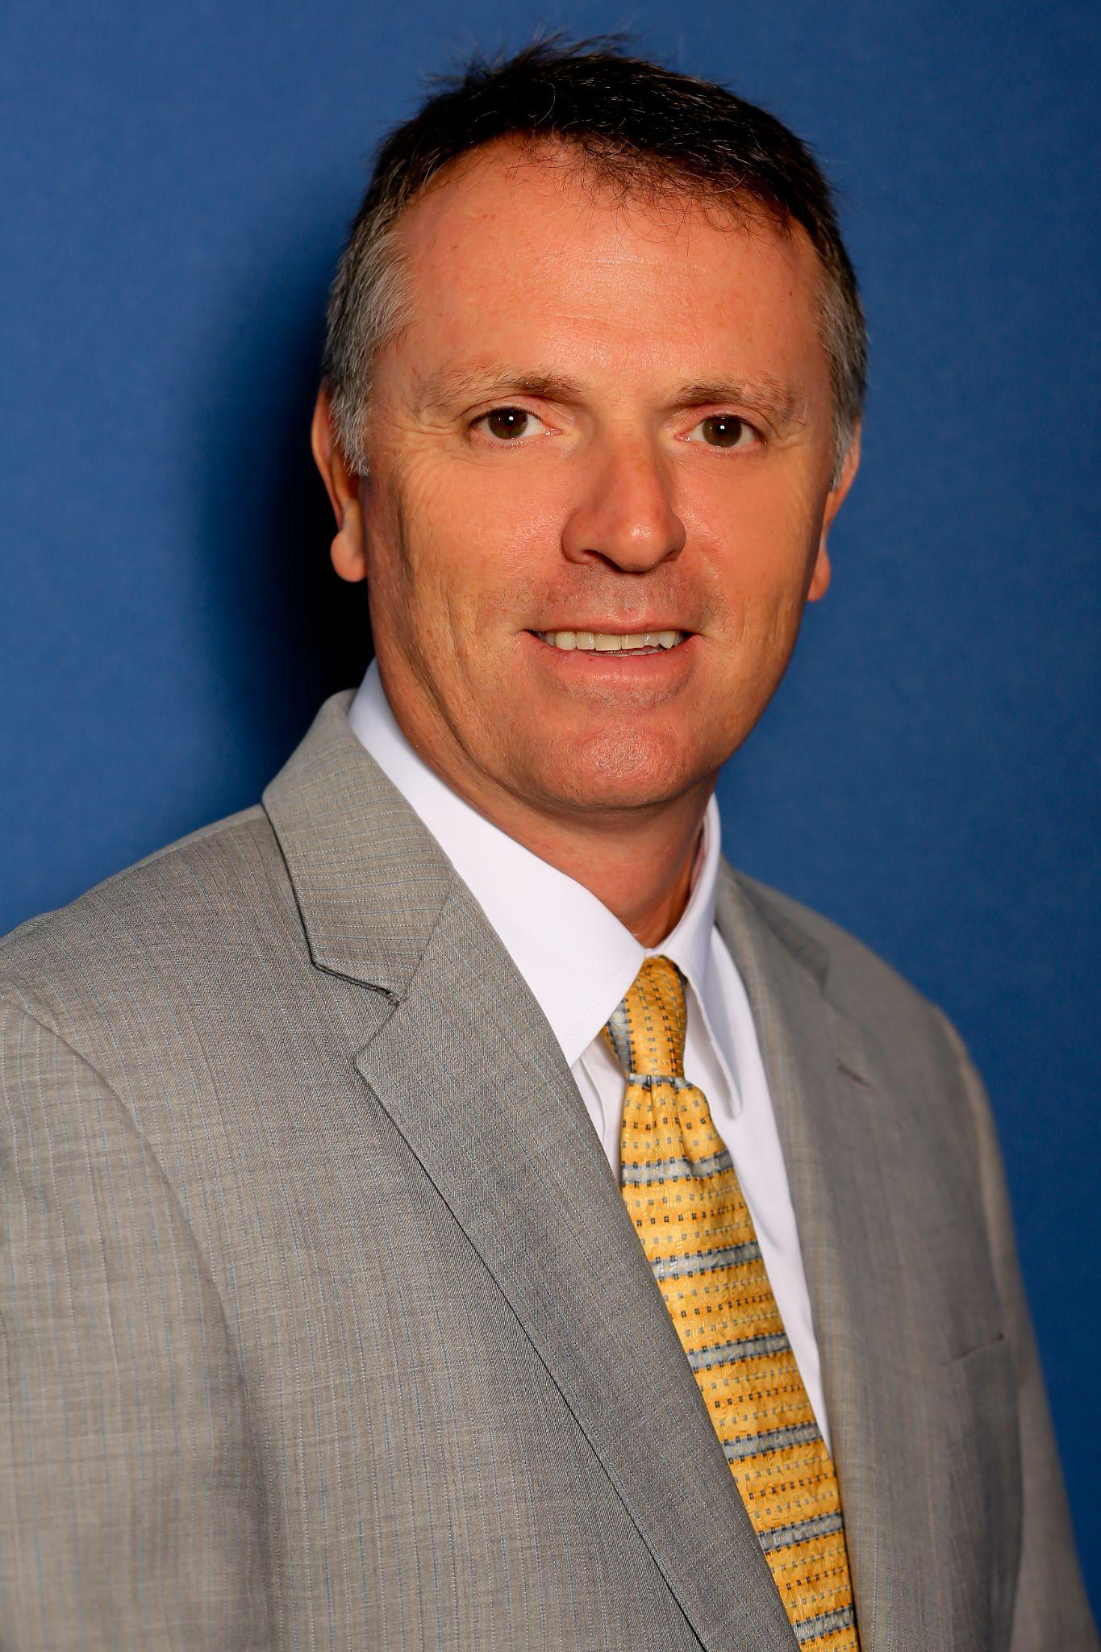
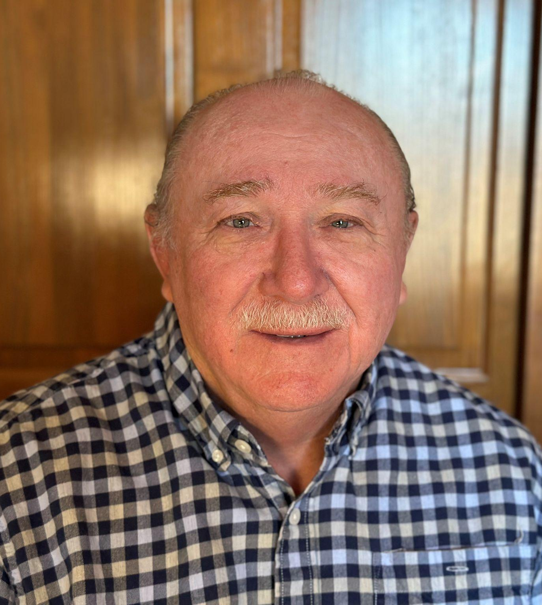
Illinois Green Economy Network
David Husemoller, Executive Director
Curt Rendall, EdD
IGEN Grant Coach/Consultant
Tim Gibson,
Program Coordinator
Brad McCormick, Program Coordinator
Rob Hilgenbrink, Program Coordinator & Financial Advisor
Notes:
IGEN

Slide 33
Rev Up EV round 3 Colleges and IGEN Coaches
Tim Gibson | John A. Logan – R1 & R3
 | Illinois Valley – R2
 | Kaskaskia – R1 & R3
 | Rend Lake – R1 & R3
 | Richland – R1
 | Rock Valley – R1 & R3
Robert Hilgenbrink | College of DuPage – R1
 | Heartland – R1 & R3
 | Joliet – R1
 | John Wood – R2
 | Triton – R1 & R3
 | Waubonsee – R2
David Husemoller | Daley @ CCC – R1 & R3
 | Kennedy King @ CCC – R1 & R3
 | Olive Harvey @ CCC – R1 & R3
 | Truman @ CCC – R1 & R3
 | McHenry County College – R1
 | Oakton – R1 & R3
Brad McCormick | Danville Area CC – R1
 | Illinois Central – R2 & R3
 | Kishwaukee – R1 & R3
 | Morton – R1
 | Parkland – R1
 | Shawnee – R2
Elgin – R3
Lincoln Land – R3
Curt Rendall | College of Lake County – R1 & R3
 | Kankakee – R1
 | Lake Land – R1 & R3
 | Moraine Valley – R1 & R3
 | Prairie State – R1
 | Southeastern – R1 & R3
Notes:
IGEN

Slide 34



IGEN Coordinated Professional Development
Specialized Faculty EV Training Options
Basic EV training for those who may be new to EV technology
Weber State
AVTG
Advanced EV training
New Zealand Level 5 Automotive Engineering Certificate (PT, Online August ‘24 - June ‘25)
Rivian Manufacturer Specific Training
Specialized Faculty Heavy Duty & EV Charging Infrastructure Options
Charging:
EVITP; EV Box and Rivian Manufacturer Specific Trainings
Heavy-duty -
Basic introductory training includes high voltage battery safety
Faculty are welcome to complete multiple trainings during the performance period.
Notes:
IGEN

Slide 35
Industry Collaborative Meetings
Industry Collaborative (employers, educational institutions, and state agencies)
Guide the development of training that satisfies industry demand for highly skilled individuals
Tracks in Passenger & Light Duty EV
Medium and Heavy-duty EV
EV Charging Infrastructure Installer/Technician
Notes:
IGEN

Slide 36
EV Network & TA Meetings
Tentatively scheduled for first Monday of every month at 11 am via Zoom
Aug. 5, 2024, TA
Sept 9, 2024, EV Network
Oct. 7, 2024, TA
Nov. 4, 2024, EV Network
Dec. 2, 2024, TA
Jan. 6, 2025, EV Network
Feb. 3, 2025, TA
March 3, 2025, EV Network
April 7, 2025 TA
May 5, 2025, EV Network
June 2, 2025, TA
Notes:
IGEN
Share updated EV network meeting schedule.

Slide 37


Curriculum and Stackable Certificate Development
August 2024 – June/July 2025 timeframe
Major competencies, Master syllabus, program outlines
March/April 2024 – IGEN/EV Network forms curriculum working groups in Passenger EV; Heavy-duty; EV Charging Infrastructure
Sept 2024 - Industry feedback on assessment frameworks
Oct. 2024 – June/July 2025 timeframe
Curriculum working groups build out curriculum resources, labs, assessment rubrics
Spring 2025 updates to come this fall
Past industry collaborative events:
March 1, 2024: Charging Infrastructure - Industry Collaborative Meeting at Daley College
May 30, 2024: EV Open house event at Heartland with tours of Rivian and Connect Transit
Notes:
IGEN
NEEDS UPDATED from AUGUST 2024-Fall 2025 – critical to mention the forthcoming Drive-In event → Fall 2025, central location TBD, colleges can host individual events with press releases and local media coverage, including social media coverage.

Slide 38

AVTG training
David Macholz
Advanced Vehicle Technology Group
Assistant Dean - Transportation Programs - Suffolk County Community College
Electric Vehicle Train-the-Trainer Bootcamp
An Intensive Electric Vehicle Bootcamp for Automotive Instructors
3 Days $2,995.00
The transition to electric vehicles and other advanced technologies provides a unique challenge to secondary and post-secondary automotive technology programs and instructors. This course will explore these new technologies and provide educators the knowledge and skills to take these programs from planning through implementation.
Notes:
IGEN

Slide 39
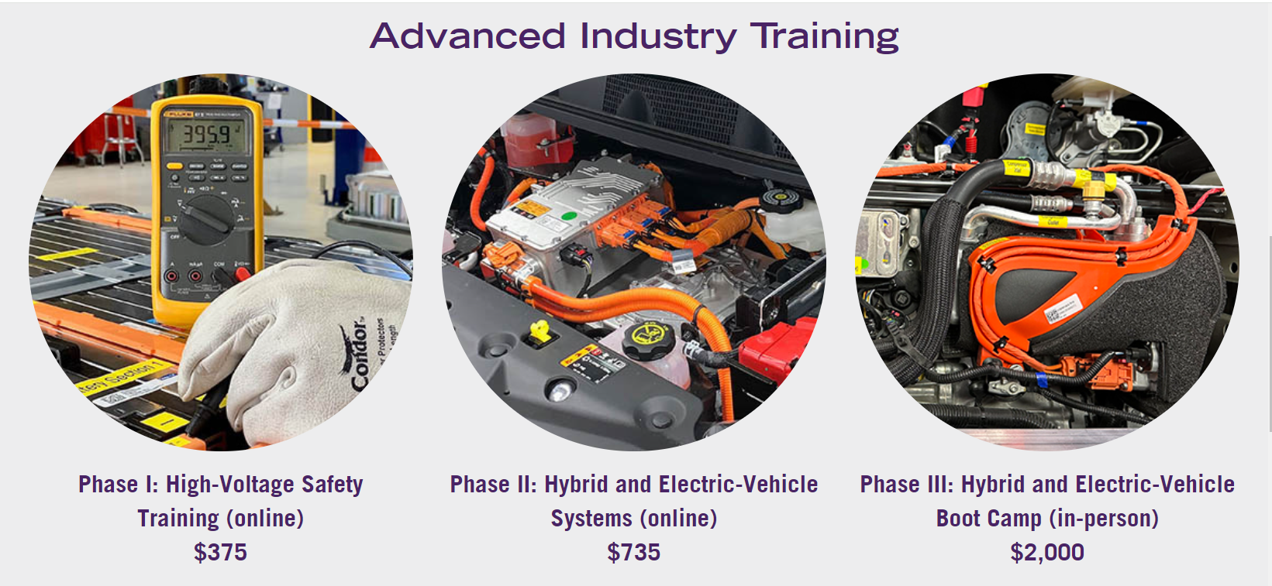
Notes:
IGEN

Slide 40
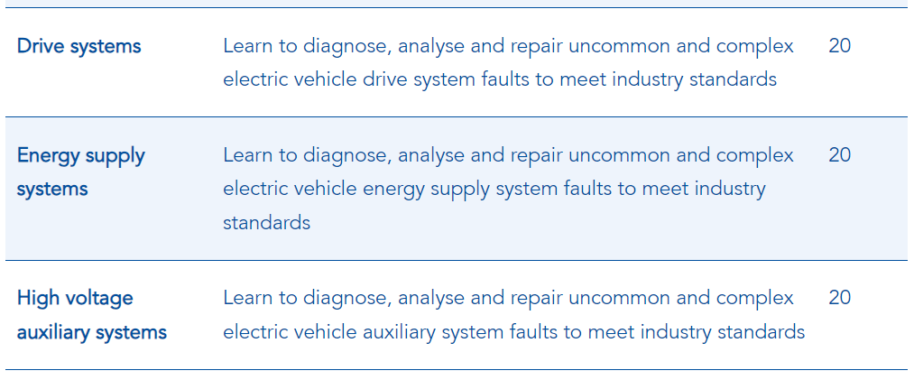
Part-Time
Online
1st week of August 2024
-
June 2025
Notes:
IGEN
Turn it back over to Dana for wrap up.

Slide 41

Questions? Send any additional questions to ICCB.cte@illinois.gov.
Notes:
Dana. Wrap up – send questions to ICCB.cte@Illinois.gov email inbox
Next steps: Follow up with your corresponding IGEN coaches to connect with folks from other Rev Up EV community colleges.
Upcoming technical assistance sessions in April and June, the IGEN conference hosted at Kankakee Community College on Wednesday, April 2nd and 3rd, the Rev Up EV industry collaborative will be held on Wednesday, May 28th at TCCI Manufacturing in Decatur, and a fall 2025 “EV Drive-In” event aimed to include students.

